Slide 1
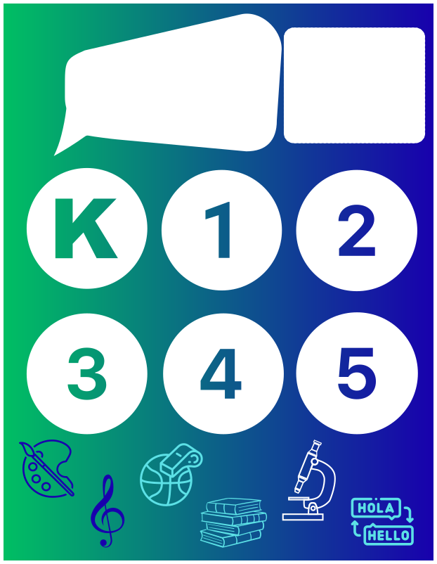

SPECIALS
SELECT A GRADE LEVEL TO READ MORE ABOUT WHAT WE HAVE BEEN LEARNING IN SPECIALS DURING THE THIRD QUARTER!
NEWS

Slide 2



SPECIALS
NEWS
KINDERGARTEN
3rd QUARTER 2025-2026
IN ART...
IN PE...
Students have been learning about weaving. Students have been using yarn and learning how to use their hands as the loom, creating finger knitting. We have advanced to weaving on their own wooden loom of crossed popsicle sticks! They are beautiful! Next, we will be moving into a clay unit!
During February (Heart Month), students completed our Health and Fitness Unit. They learned about heart health, MyPlate, and the four areas of fitness. We explored these ideas through fun movement activities, such as jump rope.
We are now beginning our Striking Unit. Students will practice striking skills and explore sports such as baseball, tennis, golf, hockey, and bowling.
IN SCIENCE..
STUDENTS HAVE BEEN OBSERVING THE WEATHER AND ITS CHANGES LIKE SUNNY, CLOUDY, RAINY, WINDY, AND SNOWY.
WE HAVE ALSO LEARNED ABOUT THE 4 SEASONS AND WEATHER ASSOCIATED WITH EACH.
IN MUSIC...
Kindergarten students have continued to review opposites in music. We have also been learning about steady beat. We have been singing, moving, and playing to demonstrate our steady beat skills!
IN SPANISH...
IN THE MEDIA CENTER
STUDENTS HAVE BEEN LEARNING ABOUT THE OPPOSITES OF BIG – SMALL, FAST – SLOW, AND UP - DOWN.
WE HAVE BEEN IDENTIFYING THESE OPPOSITES THROUGH MOVEMENT, IMAGES, LISTENING TO SONGS, AND GAMES.
STUDENTS HAVE BEEN EXPLORING CULTURES THROUGH STORIES, AND PRACTICING SEL SKILLS,.

Slide 3
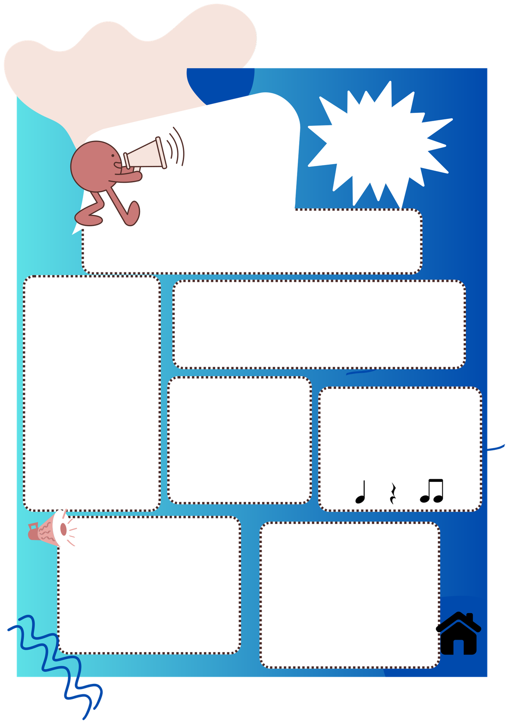

SPECIALS
NEWS
1ST GRADE
YOUR RBES 3rd Q SPECIALIST NEWSLETTER
IN ART...
Students have been learning about weaving. Students have been using yarn and learning how to use their hands as the loom, creating finger knitting. We have advanced to weaving on their own wooden loom of crossed popsicle sticks! They are beautiful! Next, we will be moving into a clay unit.
IN PE...
During February (Heart Month), students completed our Health and Fitness Unit. They learned about heart health, MyPlate, and the four areas of fitness. We explored these ideas through fun movement activities, such as jump rope.
We are now beginning our Striking Unit. Students will practice striking skills and explore sports such as baseball, tennis, golf, hockey, and bowling.
IN SCIENCE..
STUDENTS HAVE BEEN
INVESTIGATING EARTH MATERIALS. THEY DESCRIBE THE PHYSICAL PROPERTIES AND NOTE THE SIMILARITIES AND DIFFERENCES IN VARIOUS EARTH MATERIALS LIKE ROCKS, MINERALS AND SOILS.
IN MUSIC...
While continuing to review rhythm, students have been learning about pitch. We are also learning about the instruments of the orchestra.
IN SPANISH...
IN THE MEDIA CENTER
STUDENTS HAVE LEARNED ABOUT FAMILY MEMBERS. WE PLACE A STRONG EMPHASIS ON PRONUNCIATION AND LISTENING COMPREHENSION. NOW, STUDENTS ARE CREATING PORTRAITS OF THEIR FAMILIES AND LABELING EACH FAMILY MEMBER WITH THE CORRESPONDING SPANISH VOCABULARY WORD.
STUDENTS HAVE BEEN EXPLORING CULTURES THROUGH STORIES, AND PRACTICING SEL SKILLS

Slide 4
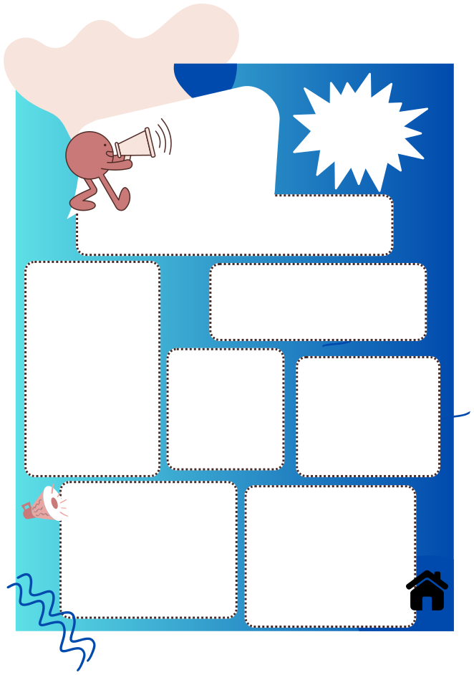
SPECIALS
NEWS
2ND GRADE
YOUR RBES 3RD Q SPECIALIST NEWSLETTER
IN ART...
Students have been learning about weaving. Students have been using yarn and learning how to use their hands as the loom, creating finger knitting. We have advanced to weaving on their own wooden loom of crossed popsicle sticks! They are beautiful! Next, we will be moving into a clay unit.
IN PE...
During February (Heart Month), students completed our Health and Fitness Unit. They learned about heart health, MyPlate, and the four areas of fitness. We explored these ideas through fun movement activities, such as jump rope.
We are now beginning our Striking Unit. Students will practice striking skills and explore sports such as baseball, tennis, golf, hockey, and bowling.
IN SCIENCE..
STUDENTS HAVE INVESTIGATED WEATHER PATTERNS AND THE TOOLS USED TO MEASURE AND COLLECT WEATHER DATA.
IN MUSIC...
2nd grade has finished up learning about the instruments of the orchestra. Students have moved to learning about how musicians read pitch using the staff using our solfege scale (do, re, mi...).
IN SPANISH...
IN THE MEDIA CENTER
STUDENTS HAVE LEARNED VOCABULARY FOR FAMILY MEMBERS IN SPANISH.
THEY ALSO PRACTICED USING THE ARTICLES “EL” AND “LA” WITH THIS VOCABULARY. NOW, THEY ARE APPLYING WHAT THEY’VE LEARNED BY WRITING SHORT SENTENCES ABOUT THEIR FAMILIES.
STUDENTS HAVE BEEN EXPLORING CULTURES THROUGH STORIES, AND PRACTICING SEL SKILLS

Slide 5

SPECIALS
NEWS
3RD GRADE
YOUR RBES 3RD Q SPECIALIST NEWSLETTER
IN ART...
IN PE...
Students have been learning about weaving. Students have been using yarn and learning how to use their hands as the loom, creating finger knitting. We have advanced to weaving on their own wooden loom of crossed popsicle sticks! They are beautiful! Next, we will be moving into a 3-D clay unit.
During February (Heart Month), students completed our Health and Fitness Unit. They learned about heart health, MyPlate, and the four areas of fitness. We explored these ideas through fun movement activities, such as jump rope.
We are now beginning our Striking Unit. Students will practice striking skills and explore sports such as baseball, tennis, golf, hockey, and bowling.
IN MUSIC...
IN SCIENCE..
STUDENTS LEARNED THE SUN CHANGES ITS APPARENT POSITION IN THE SKY THROUGHOUT THE DAY AS THE EARTH ROTATES. SHADOWS OF OBJECTS MOVE WITH THOSE CHANGES.
3rd grade students have been learning about musicals and the unique ways performances can be used to tell a story. We have explored the various jobs in performing a musical as we have enjoyed watching “Peter Pan” in connection with ELA..
IN THE MEDIA CENTER
IN SPANISH...
STUDENTS HAVE LEARNED NEW VOCABULARY RELATED TO FAMILY MEMBERS. THEY ALSO PRACTICE USING THE ARTICLES “EL”, “LA”, AND “LOS” WITH FAMILY MEMBER VOCABULARY.
NOW, STUDENTS ARE WORKING ON ANSWERING QUESTIONS BASED ON A FAMILY TREE.
STUDENTS WILL ALSO BE WORKING ON A PROJECT ABOUT THEIR OWN FAMILY TREE.
STUDENTS HAVE BEEN PRACTICING DRAWING CONCLUSIONS, MAKING INFERENCES, AND ASKING AND ANSWERING QUESTIONS ABOUT KEY DETAILS IN A FICTIONAL TEXT.

Slide 6
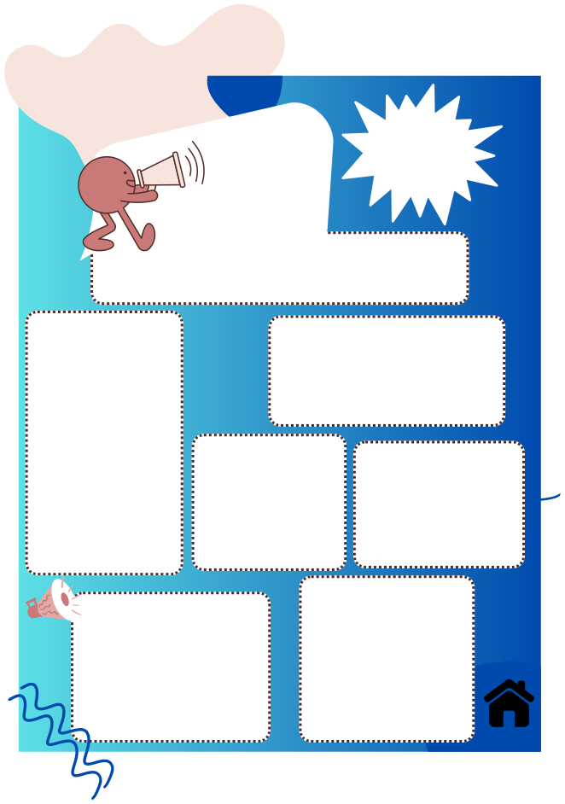
SPECIALS
NEWS
4TH GRADE
YOUR RBES 3RD Q SPECIALIST NEWSLETTER
IN ART...
IN PE...
Students have been learning about weaving. Students have been using yarn and learning how to use their hands as the loom, creating finger knitting. We have advanced to weaving on their own wooden loom of crossed popsicle sticks! They are beautiful! Next, we will be moving into a
3-D clay unit
During February (Heart Month), students completed our Health and Fitness Unit. They learned about heart health, MyPlate, and the four areas of fitness. We explored these ideas through fun movement activities, such as jump rope.
We are now beginning our Striking Unit. Students will practice striking skills and explore sports such as baseball, tennis, golf, hockey, and bowling.
IN SCIENCE..
STUDENTS HAVE
IN MUSIC...
Students have been learning the proper ways to play the recorder. We are now applying our music reading skills to play songs on the recorder.
INVESTIGATED FOSSILS WHICH ARE EVIDENCE OF LIFE FROM THE PAST. FOSSILS ARE ANIMALS AND PLANTS AND THEY PROVIDE INFORMATION ABOUT PAST ENVIRONMENT.
IN THE MEDIA CENTER
IN SPANISH...
STUDENTS HAVE BEEN PRACTICING DRAWING CONCLUSIONS, MAKING INFERENCES, AND ASKING AND ANSWERING QUESTIONS ABOUT KEY DETAILS IN A FICTIONAL TEXT.
STUDENTS WERE EXPLORING NEW VOCABULARY RELATED TO COMMUNITY HELPERS. THEY ARE PRACTICING HOW TO ASK AND ANSWER QUESTIONS USING QUIÉN (WHO) AND DÓNDE (WHERE) TO IDENTIFY THESE COMMUNITY HELPERS AND THEEIR WORKPLACE.

Slide 7
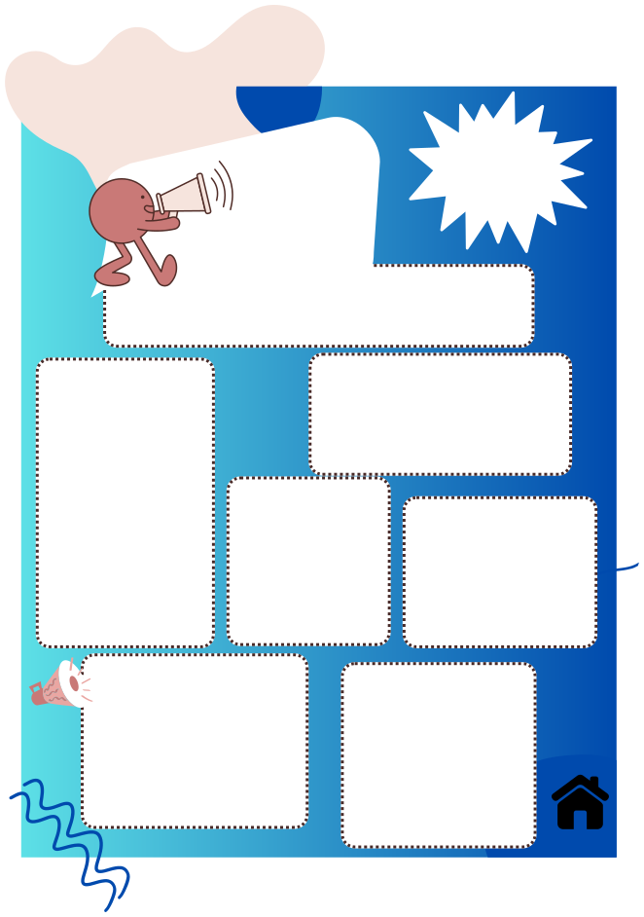
SPECIALS
5TH GRADE
NEWS
YOUR RBES 3RD Q SPECIALIST NEWSLETTER
IN ART...
IN PE...
Students have been learning about weaving. Students have been using yarn and learning how to use their hands as the loom, creating finger knitting. We have advanced to weaving on their own wooden loom of crossed popsicle sticks! They are beautiful! Next, we will be moving into a 3-D
clay unit.
During February (Heart Month), students completed our Health and Fitness Unit. They learned about heart health, MyPlate, and the four areas of fitness. We explored these ideas through fun movement activities, such as jump rope.
We are now beginning our Striking Unit. Students will practice striking skills and explore sports such as baseball, tennis, golf, hockey, and bowling.
IN SCIENCE..
STUDENTS LEARNED WEATHER CONCEPTS TO BETTER UNDERSTAND CURRENT AND UPCOMING WEATHER CONDITIONS. STUDENTS CAN EXPLAIN HOW THE SUN’S ENERGY DRIVES THE WATER CYCLE.
IN MUSIC...
Students have been reviewing the basic music elements by reflecting and journaling while listening to various styles of music. We will focus on tempo, dynamics, styles, and how these are all used as a form of expression in music.
IN SPANISH...
STUDENTS ARE EXPLORING NEW VOCABULARY RELATED TO COMMUNITY HELPERS. THEY ARE PRACTICING HOW TO ASK AND ANSWER QUESTIONS USING QUIÉN (WHO) AND DÓNDE (WHERE) TO IDENTIFY THESE COMMUNITY HELPERS AND THEEIR WORKPLACE.
IN THE MEDIA CENTER
STUDENTS HAVE BEEN PRACTICING DRAWING CONCLUSIONS, MAKING INFERENCES, AND ASKING AND ANSWERING QUESTIONS ABOUT KEY DETAILS IN A FICTIONAL TEXT.

